Slide 1
Reproducible Clinical Data Analysis with R and RStudio
Session 2
Getting Data
Notes:
Welcome back

Slide 2
Introduction | 8:30 – 10:00
Getting Data | 10:10 – 11:45
Lunch | 11:45 – 12:30
Exploring Data | 12:30 – 2:30
Reproducible Reports | 2:40 – 4:00

Slide 3
Patient Data
Notes:
Before we start looking at patient data, I think it’s a good idea to stop and think about when it is OK to look at patient data, and when it isn’t.

Slide 4
When is it OK to look at patient data?
Treatment
Payment
Operations
Patient Authorization not Needed
Notes:
The Health Insurance Portability and Accountability Act of 1996 was designed to protect the privacy of patient health information
Prior to HIPAA your PHI could legally be sold or used to determine your insurance premium or mortgage rate
I won’t rehash the HIPAA training but will only point out that as a health care provider or “covered entity”, you are allowed to access, use, or disclose PHI without patient authorization for 3 general umbrella purposes--
Treatment
Payment
Healthcare Operations
(TPO)
Normally when you look up an individual patient, the reason why you don’t have to ask for permission is Treatment. In contrast, when you look at patient data for quality and patient safety efforts, it's Operations.

Slide 5
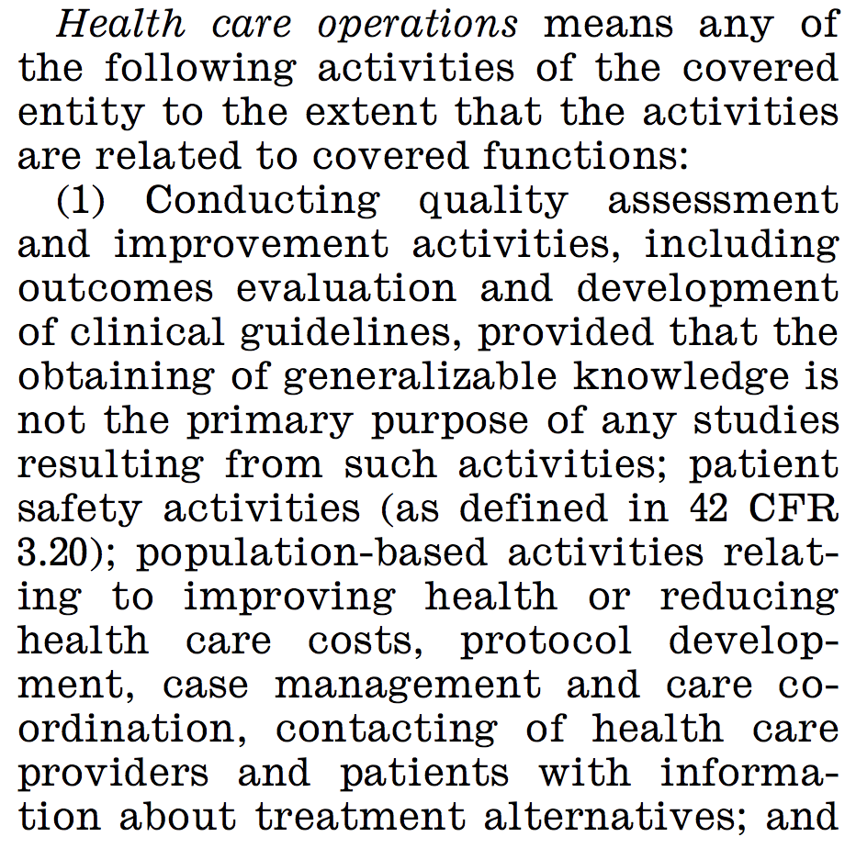
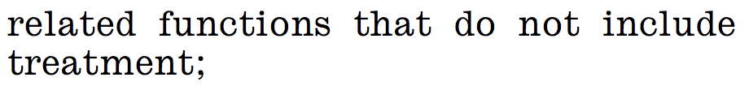
The Definition of “Healthcare Operations” Explicitly Includes Quality Improvement Activities
45 CFR 164.501
Notes:
This is from the 2017 version of the Code of Federal Regulations, Title 45 (DHHS), definition of “Healthcare Operations”, the “O” in “TPO”.
* You can see that the definition of Operations explicitly includes Quality Improvement activities---
* as long as the *primary* purpose isn’t published research.
This means that for quality improvement activities, you're allowed access to identified patient data without first having to ask permission from the patients or going through an institutional review board.

Slide 6
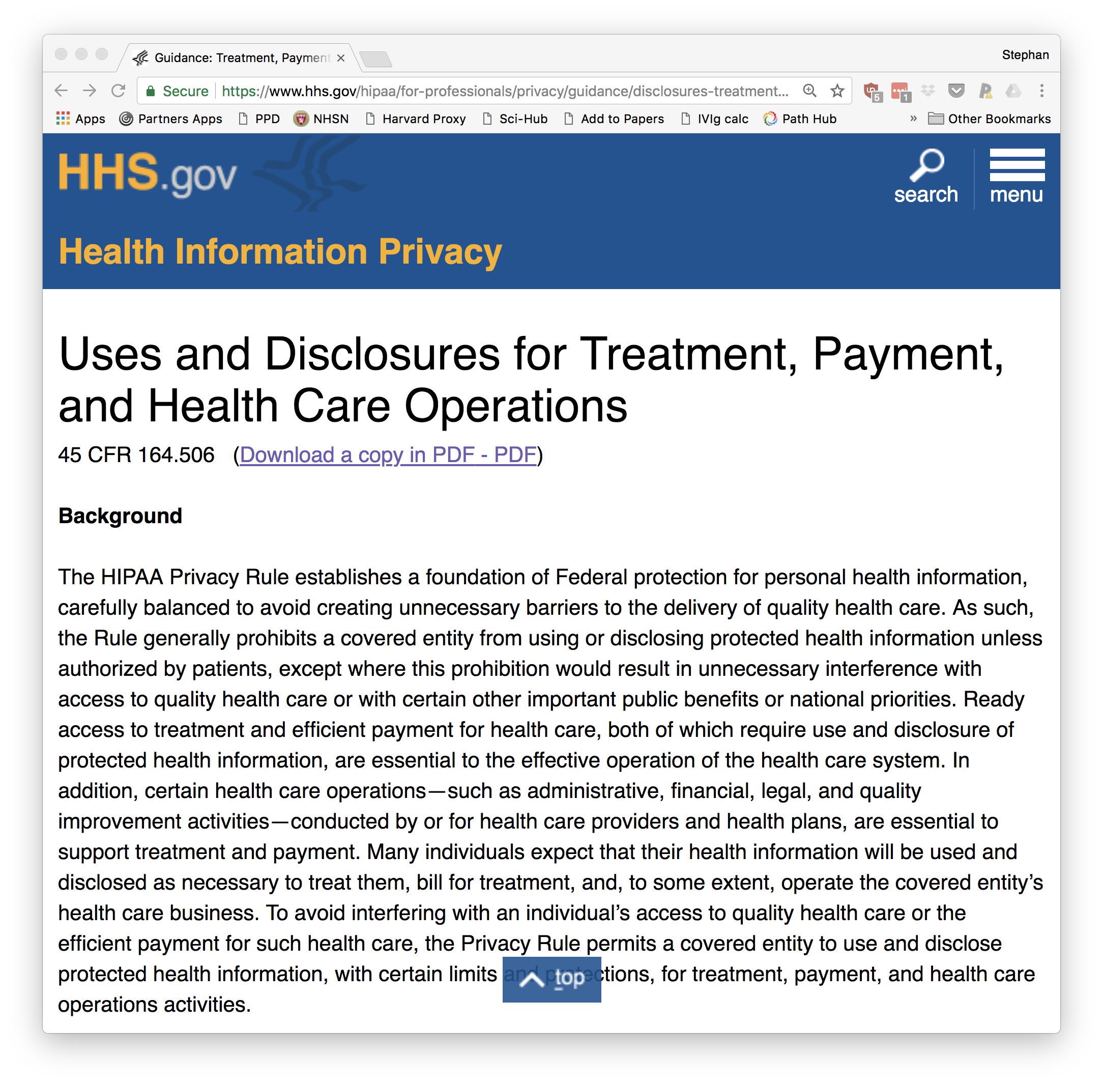
Notes:
HHS.gov has fairly readable explainers of the HIPAA privacy rule and its TPO exceptions.
There are also good articles about how to de-identify PHI, which is something we won’t have time to go into.
A final point I'd like to make is that whenever you work with identified patient data, even when you’re going by the rules, challenge yourself to think of ways to minimize the risk of data loss as well as the potential impact if you were to lose the data. For example, do you need to use actual patient names or are MRNs good enough?

Slide 7
Importing Data

Slide 8

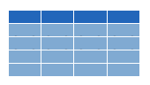

Why bother?
csv
Data frame
xls
db
Notes:
Every data analysis starts with data, and that data is stored primarily in two ways: in files on your computer’s hard drive; or in online databases.
Before R can manipulate data, you need to load it into R’s memory. This is a process called Importing or Reading.
* The most common scenarios in clinical data analysis are importing data from a CSV file, an Excel file, or directly from a database. The data will then exist in R’s memory as an object called a “data frame”

Slide 9
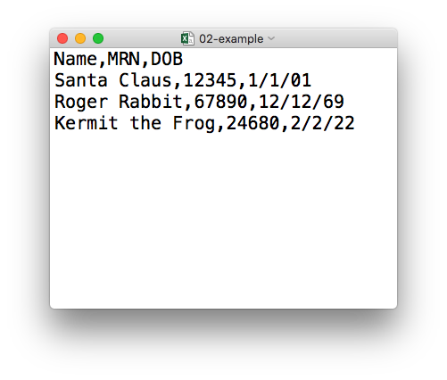
plain text (“flat”) file
csv
rectangular structure
header row
Notes:
So what’s a CSV file? CSV stands for comma-separated values.
* A CSV file is a plain text file, which means you can open it in a text editor and look at it.
Here we have a CSV file with the names, MRNs, and date of birth of three “patients”
* This data structure is called rectangular because it falls into rows and columns, where each row has the same # of columns, and each columns has the same # of rows.
* Also note that this particular CSV file has a header row that, instead of data, has a descriptor of what kinds of data are found in each column. CSV files often but not always have such a header row.

Slide 10
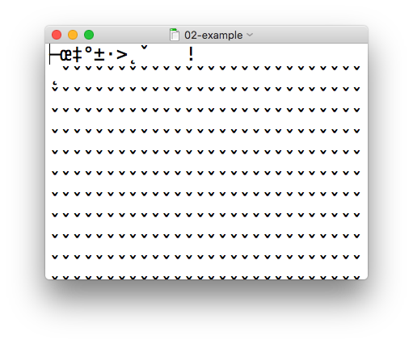
csv
xls
Notes:
In contrast, an Excel file is written in a binary format that looks like a jumbled mess when you try to load it in a text editor.
The good news is, R is perfectly capable of loading both CSV and Excel files.

Slide 11

Import flat rectangular data files (.csv, .tsv, ...)
library(readr)
Alternatively,
library(tidyverse)
Notes:
We’ll be using the readr package, which is part of the tidyverse, to read a CSV file.
Remember that to load a package you use the library() command. In this case you’ll want to load the readr package.
* It’s also OK to load the tidyverse package. The tidyverse package is what's called a *meta-package*. A meta-package doesn't actually contain any data or functions by itself but rather makes R pull in a predefined set of other packages. So running library(tidyverse) loads readr and a couple of other packages that frequently used together for data analysis and visualization.

Slide 12
read_csv()
data_frame <- read_csv(file_name)
csv
Notes:
You can import CSV files using the read_csv() function. Here is a template for how to use the read_csv function to create a data frame object from a CSV file. You start with the name of a data frame object then you have this left-ward arrow then read_csv and then the file name in parentheses.

Slide 13
Aside: R Syntax Basics
function
(does stuff)
data_frame <- read_csv(file_name)
Notes:
This code construct is exceedingly common in R, so I want to spend a few minutes exploring it.
read_csv() is a function. Remember that functions are defined in packages. We loaded the readr package (which is part of the tidyverse set of packages) to be able to use the read_csv function.
You all remember functions from calculus. It’s something that takes an input, say an ‘x’ value and returns an output, say a ’y’ value. Functions in computer programming also take input and return outputs. But the inputs and outputs here are objects that exist within the context of a programming language. For read_csv, the input is a the file name of a CSV file; and the output is a data frame with the contents of the file.

Slide 14
Aside: R Syntax Basics
function
(does stuff)
argument
(input)
data_frame <- read_csv(file_name)
Notes:
The input that goes into a function is called an argument. The argument to a function gets put in parentheses.
A function can have zero, one, or many arguments. If there is more than one argument, you’d use commas to separate them. We’ll see examples of that later.

Slide 15
Aside: R Syntax Basics
object
(stores output)
function
(does stuff)
argument
(input)
data_frame <- read_csv(file_name)
Notes:
- So again, read_csv outputs a data frame, but we want to *capture* that data frame inside of a named object. The reason is that we want to hand that object to other functions so they can do other stuff with it, for example, summarize or visualize the data in it.

Slide 16
Aside: R Syntax Basics
object
(stores output)
function
(does stuff)
argument
(input)
data_frame <- read_csv(file_name)
assignment operator
(“gets”)
Notes:
To put the output of the read_csv function into a named object, you use the assignment operator.
The assignment operator is a smaller-than followed by a dash or minus and looks kind of like an arrow pointing left. It’s usually read as “gets.”

Slide 17
read_csv()
data frame to read data into
name of
CSV file
test_df <- read_csv("test_data.csv")
test_df
test_data.csv
csv
Notes:
So, for example in this line of code the object test_df gets a data frame created by read_csv as it reads a file named test_data.csv.
The line reads “test_df gets read_csv of test_data.csv.”
You might notice that one of the objects is put in quotes and the other one isn't.
To be honest, quotes can be confusing. Names of objects such as data frames don't get quotes. In contrast, literal file names are always put in quotes.

Slide 18
Aside: Naming Things
Capitalization matters
Strive for names that are concise and meaningful (not easy!)
test_df
≠
Test_df
≠
TEST_DF
Bad
Still not great
Good
p
name
patient_name
Notes:
You might have also noted that we created a new named object, test_df, and ask yourself, how should I decide how to name things.
…
If you have something that represents patient names, …
I personally recommend keeping all of your object names (data frames and columns of data frames) all lower case, with underscores between words, like patient_name. Also try to stay consistent.

Slide 19
Your Turn #2
Open 02-getting-data.Rmd. Work through the section “Your Turn #2”.

Slide 20
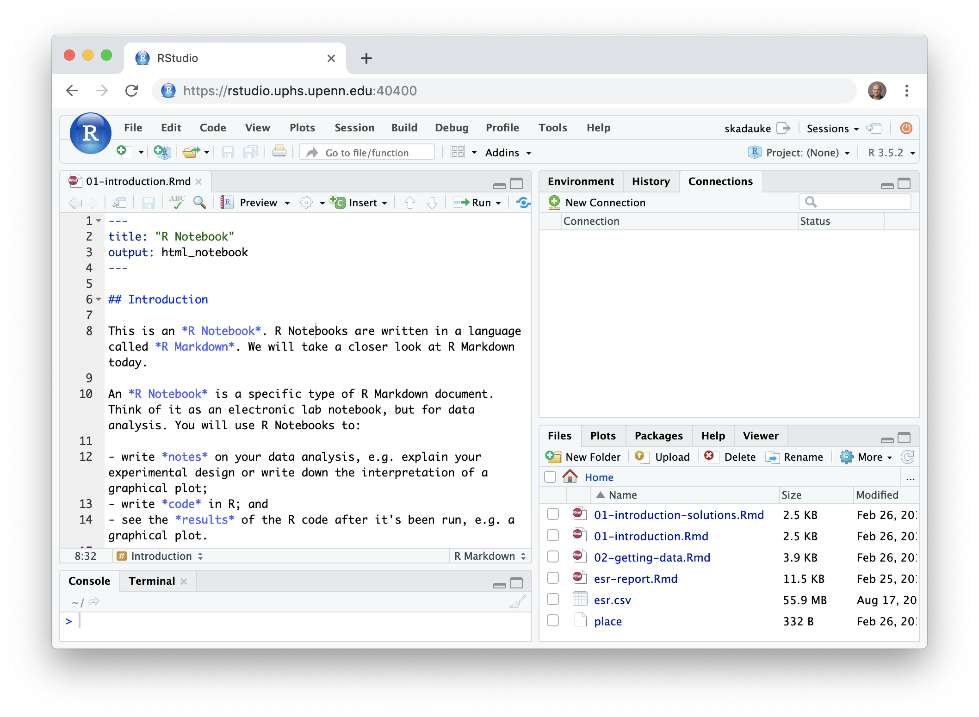
Notes:
Does everyone see this screen when logged in?

Slide 21
Import Excel files
(.xls, .xlsx)
library(readxl)
Notes:
For importing Excel files, we load the readxl package using the command library(readxl).

Slide 22
read_excel()
data frame to read data into
name of
Excel file
data_frame <- read_excel(file_name)
xls
Notes:
The function for importing an Excel file is called read_excel. It works exactly like the read_csv function.

Slide 23
How to Get Help When You Get Stuck

Slide 24
Your Turn #3
Suppose you want to import data from a file that’s similar to a CSV but uses pipes (|) instead of commas (,) as the delimiter between data fields.
Discuss with your group mates how you could figure out how to do this.

Slide 25
Notes:
This is such an important topic that I want to spend a little bit of time sharing with you what I think is the best approach.
This is the first overnight clinical pathology call I got back in July of 2014
- one of our oncologists informs me that there's a new acute leukemia patient, and there is a flow cytometry tube
- so I called the clinician and asked how I could help, and he said, I just wanted to let the lab know.
- The problem is, that I was the lab, and I didn't know what to do with that information. So I looked up the patient, reviewed the resident survival guide, and tried find a relevant SOP, but didn't really get anywhere.
- After about 10 minutes, I ended up calling my hemepath attending, told him everything I had learned about the patient and the situation, and he was able to walk me through what to do
I think that on CP call, learning happens when you spend a limited amount of time actively looking for the answer and then asking for help.

Slide 26
The Basic Approach to Getting Un-Stuck
Spend a limited amount of time actively looking for the solution
Ask for help
Notes:
I propose a similar approach to getting un-stuck with coding. Spend a limited amount of time actively looking for the solution, and then ask for help.
This process is so fundamental to programming that most programmers don’t even realize that this is what they’re doing all day long. Getting stuck with an error and dealing with it is at the core of the iterative coding process.

Slide 27

Scenario 1: Unexpected Result or Error Message
Is it really an error or just a message?
Check “spelling”
Missing quotes, commas, parentheses
Misspelled function names
Read the error message and try to make sense of it
Google the error message (cut + paste)
Ask for help using the following formula:
I tried to accomplish (goal) so I tried this code: …
I expected this: …
But instead I got this result/error: …
I’m running R/RStudio on (operating system).
Notes:
There are two common scenarios for getting stuck programming, and there is a process that I'd like you to think of to deal with them.
The first scenario is that you write some code and get an unexpected result or error message.
An idiosyncracy of R that’s confusing in the beginning is that it often spits out messages written in angry looking red letters, so they can be easily mistaken for errors. We saw an example of this in the first Your Turn. The way to tell if there’s an error is, it should say “error” somewhere in the message.
If you’re dealing with an error, the first step should always be to check for spelling errors - missing quotes, commas, or parentheses, and misspelled function names are extremely common sources of errors.
Then, actually read the error message. It may be cryptic but often you might find a clue in there that helps point at the problem.
Then, cut and paste the error message into Google. This is a powerful way to find solutions to common problems.
When all of these steps fail, you're done actively looking for the solution, so it's time to ask for help, usually by emailing someone who knows more R than you. Here is formula that makes it easy for that person to help you.
...

Slide 28
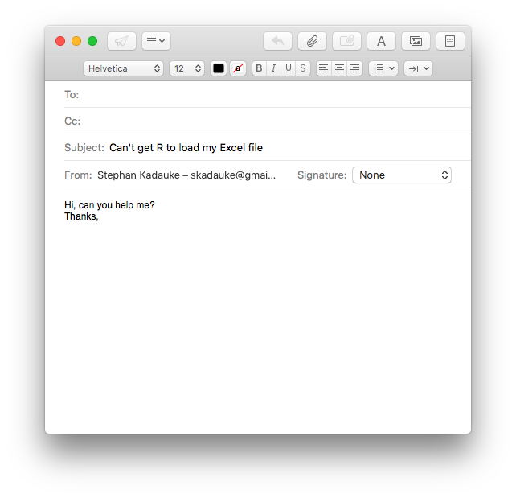
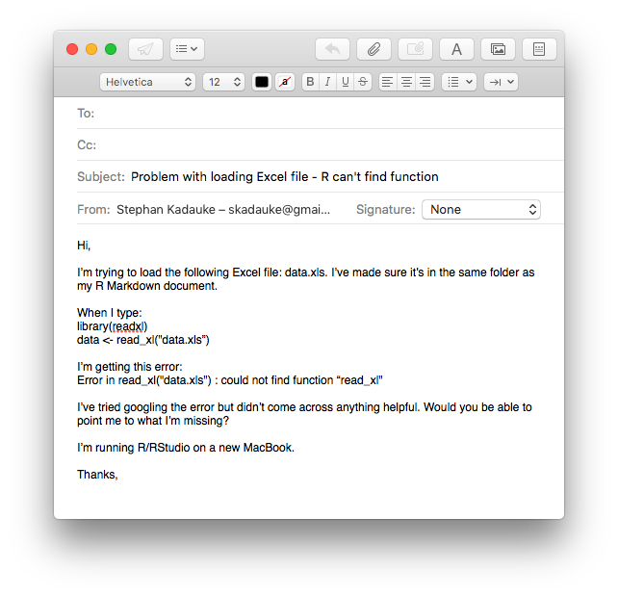
Notes:
To illustrate the power of this recipe, consider this email, which is similar to many emails I've gotten before.
...
This email gives me very little information about the problem that this person is encountering. I also don’t know what that person has already tried to solve the problem, but my guess is not very much.
* Consider this email, in contrast.
...
This email gives me a lot more to work with, importantly the code that was entered, and the error message. It also gives me an idea of what this person tried to do to fix the problem. Because the code and the error message are provided, I can actually tell immediately what the problem is, namely the function name read_excel is misspelled (should be e-x-c-e-l not x-l), which is a easy mistake to make, and can be hard to find by googling.
I am much more likely to write a helpful answer to the second email than to the first.

Slide 29

Scenario 2: You Know What You Want to Do But Don’t Know How to Do it in R
If you think you know what function to use:
RStudio Cheat Sheets
Google
Extremely powerful
But there’s an art to this
Less useful for very basic questions
Ask for help (on Slack!)
Do a tutorial (can be great when you feel totally lost)
?function
Notes:
The second scenario is that you think you know *what* you want to do but don't know *how* to do it in R.
There's a built-in help in R that we'll look at in a moment. This is useful if you think you already know the function you want to use but want to learn how to use it for a specific purpose.
RStudio makes cheat sheets, and we'll look at an example in a moment.
Google - can be very powerful but can easily send you down a rabbit hole. It's not that useful for very basic questions.
If you feel that there are some basic knowledge that you need to brush up on before even tackling a problem, online tutorials are the best way to go. We'll look at tutorials shortly.

Slide 30
Demo: R help
Notes:
?read_excel
Points to make:
Go to the console, Help file will pop up in the Output pane
Must have readxl loaded to follow along
The built-in help is a reference that is NOT written for beginners.
I kind of think of it as an UpToDate article. Lots of very detailed info, really hard to read through especially as a beginner, and the most useful stuff is usually at the bottom
Print these notes as you won’t be able to see them while demoing.

Slide 31
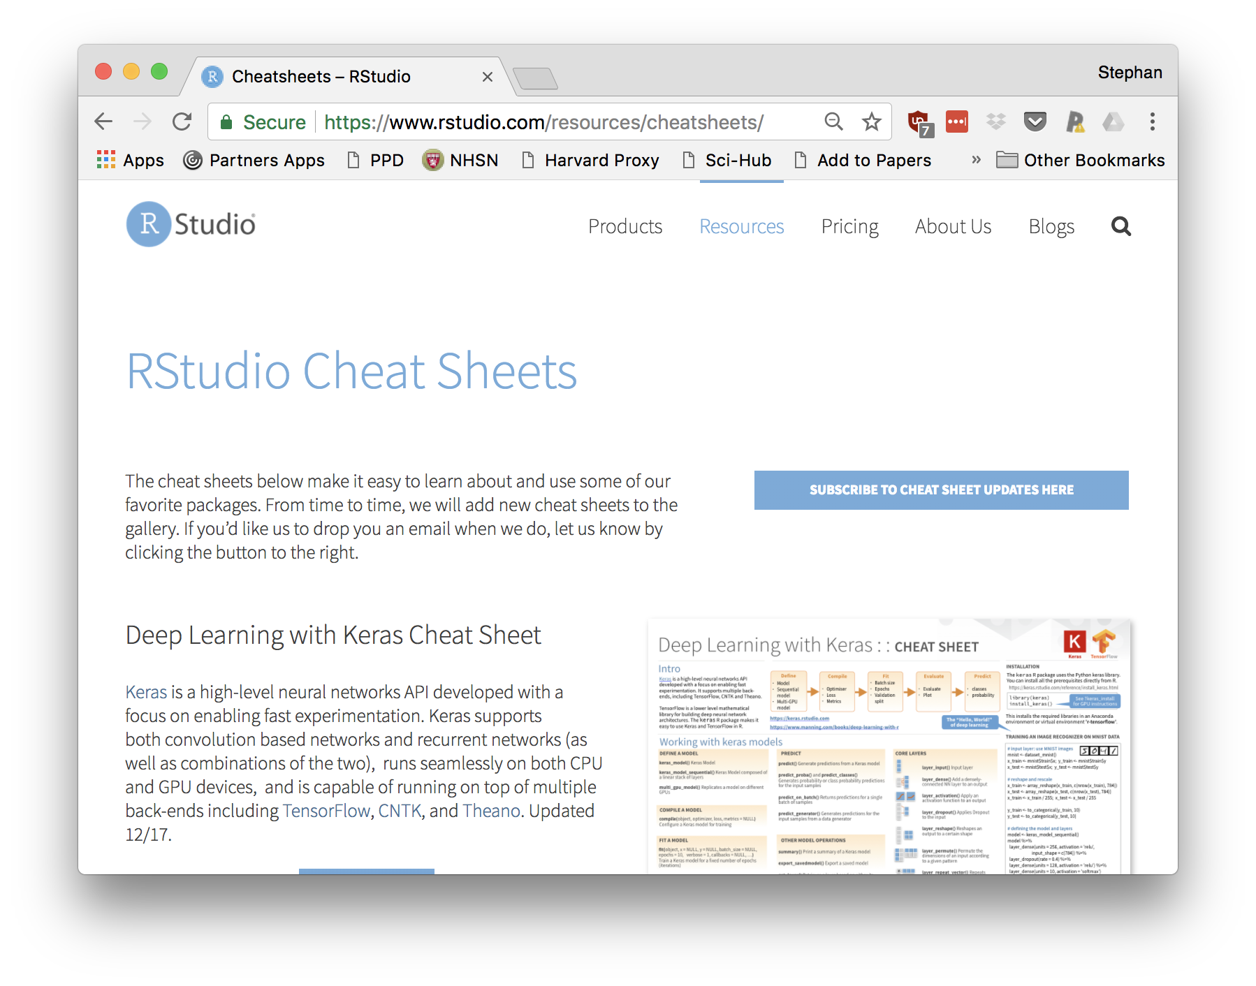
Notes:
Very good resource that's also suitable for beginners. When I'm coding in R I keep them right by my side.
Tell people to try to find the answer on the Data Import Cheat Sheet

Slide 32
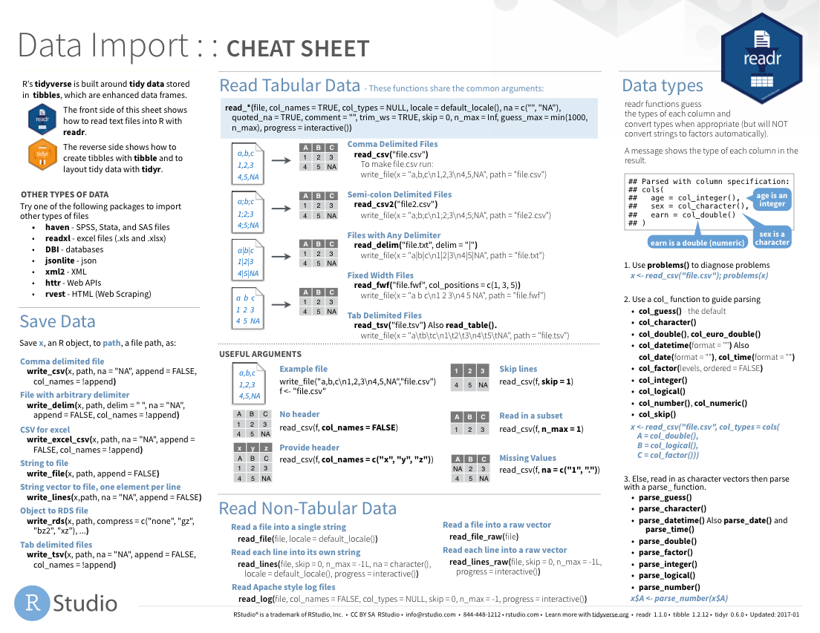
Notes:
The Data Import cheat sheet actually answers the question how to import pipe-delimited files.

Slide 33
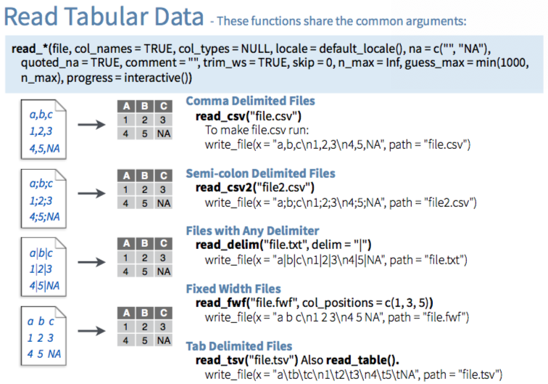

Slide 34

Notes:
An efficient way to learn a specific data analysis skill are online tutorials.
DataCamp in an online learning platform for data science. They have some of the best R data science tutorials for beginners. Usually they cost $29 a month, but through my course you’re getting access to 6 months of free DataCamp, through 01/2020.
I’ll be referring to specific Datacamp tutorials in later sessions so make sure to sign up when you get the invitation email, which I’m going to try to send out during lunch.

Slide 35
Databases

Slide 36
Database Management System
Database Tables
Database
LABS
public
RESULTS

Slide 37
select one or more columns
Database Table
Data frame
filter rows by a condition
Notes:
In contrast to reading a file, you usually don’t need or want to load an entire database table into R.
* Instead, you select columns by their name, and you filter rows by a condition.

Slide 38
Databases: Best Practices
Know and follow the rules of permissible use
Limit results when you test your database query
Let the database server do as much of the computation as possible
Notes:
When you use R to access databases like I’m going to show you, that will take care of #2 and #3.

Slide 39
Your Turn #4
Work through the section “Your Turn #4” of 02-getting-data.Rmd.

Slide 40
Notes for next time

